Slide 1
Embedded systems
Introduction to Embedded systems & C programming language
Youssef Abdelhakem
@YoussefAbdelhakem

Slide 2
Embedded systems
Outlines
What is embedded systems ?
Embedded systems characteristics ?
Embedded systems advantages and disadvantages ?
Embedded systems applications ?

Slide 3
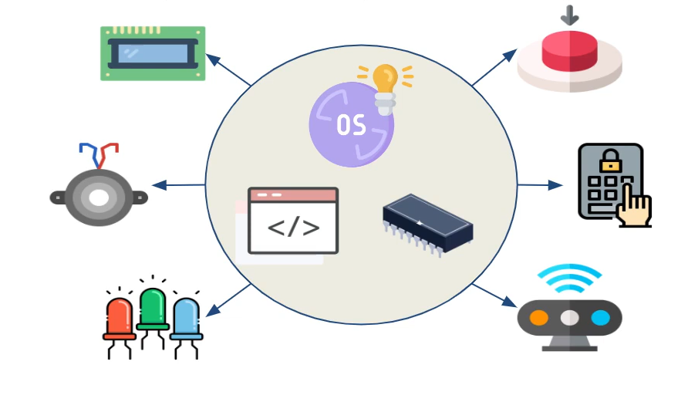
Embedded systems
What is embedded systems ?
It’s hardware controlled by software to preform specific and periodic functionality
It may be real-time or not

Slide 4
Embedded systems
Embedded systems characteristics ?
Single-functioned: repeated single functionality.
Tightly constrained: small size, speed, low power consumption.
Reactive and Real time: reacts to change in system environment.
Microprocessors based: no embedded system without a microprocessors
or a microcontroller.
Memory: limited memory size.
Connected: must be connected to input and output devices

Slide 5
Embedded systems
Embedded systems advantages and disadvantages ?
-Advantages
Easily Customizable
Low power consumption
Low cost
Enhanced performance
-Disadvantages
High development effort
Limited resources, memory, processing speed

Slide 6
Embedded systems
Embedded systems applications ?
Automotive: Cruise control, light control, ABS, EBD,ESP,.. etc.
Networking: Routers.
Fintech: ATM, Point Of Sale, Vending machines,.. etc.
Home appliances: Home automation, Air conditioners, microwave ovens, washing machines and dishwashers,... etc.
Biomedical: Wearable devices, Teleradiology.
Military: Missile targeting systems, command-and-control systems, electronic warfare.
Consumer Electronics: MP3 players, television sets, mobile phones, video game
Consoles , digital cameras, GPS receivers, printers,.. etc.

Slide 7
C programming language
Outlines
What is C programming language.?
Basic C program structure.
Hello world in C.
Variables in C.

Slide 8
C programming language
What is C programming language and why we learn it ?
C is a general-purpose programming language created by Dennis Ritchie at the Bell Laboratories in 1972.
C is strongly associated with UNIX, as it was developed to write the UNIX operating system.
It is one of the most popular programming language in the world
If you know C, you will have no problem learning other popular programming languages such as Java, Python, C++, C#, etc, as the syntax is similar
C is very fast, compared to other programming languages, like Java and Python
C is very versatile; it can be used in both applications and technologies

Slide 9
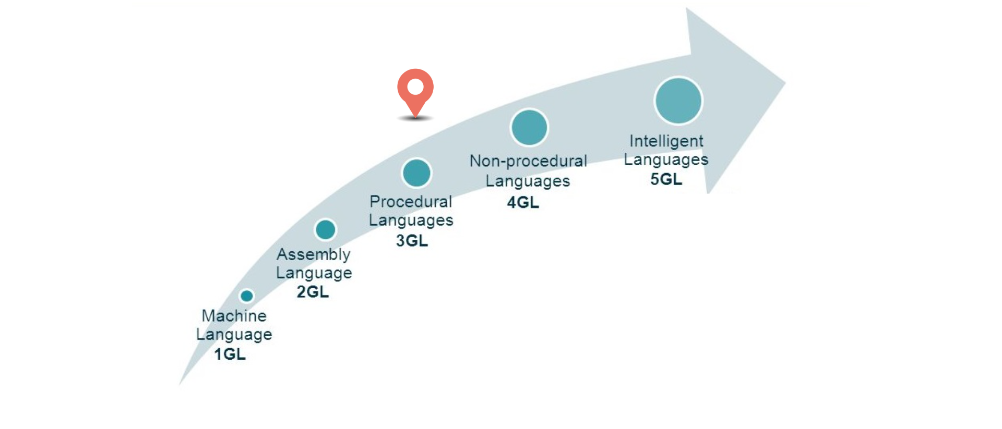
C programming language
Programming Generation Levels

Slide 10
Basic C program structure and Hello world.
#include <stdio.h>
int main() {
/* my first program in C */
// This C program to print Hello world
printf("Hello, World! \n");
return 0;
}

Slide 11
C programming language
Basic C program structure and Hello world.
# include <stdio.h> – This command is a preprocessor directive in C that includes all standard input-output functions
int main() – This is the line from where the execution of the program starts. The main() function starts the execution of any C program.
{ (Opening bracket) – This indicates the beginning of any function in the program (Here it indicates the beginning of the main function).
/* some comments */ – Whatever is inside /*——-*/ are not compiled and executed; they are only written for user understanding or for making the program interactive by inserting a comment
printf(“Hello World”) –The printf() command is included in the C stdio.h library, which helps to display the message on the output screen.
return 0 –This command terminates the C program and returns a null value, that is, 0.
} (Closing brackets)- This indicates the end of the function. (Here it indicates the end of the main function)

Slide 12
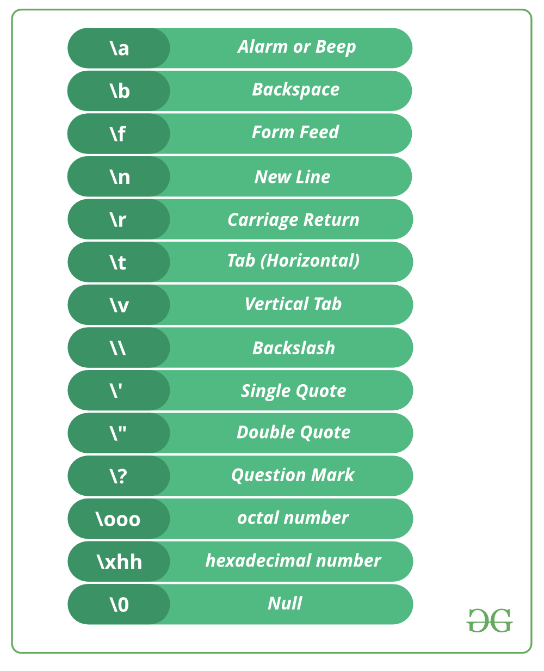
C programming language
Escape Sequences in C

Slide 13
#include<stdio.h>
int main()
{
printf(“Youssef\n");
printf(“Abdelhakem\t\n");
printf(“Embedded systems\\");
}

Slide 14
C programming language
Data types in C
Primitive (Primary) Data Types : These data types store fundamental data used in the C programming.
int : Only integers, it`s with size : 4 Byte
long long : Only integers, it`s with size : 8 Byte
float : Decimals and integers, it`s with size : 4 Byte
double : Decimals and integers, it`s with size : 8 Byte
char : Symbols, it`s with size : 1 Byte
Derived and User Defined Data Types : These are made by collection or combination of primitive data types (Array ,Structure , Union , Enums)

Slide 15
C programming language
Signed Data types
Data type
Range
Format Specifier
%d-%i
int : 4 Byte
long : 8 Byte
float : 4 Byte
double : 8 Byte
char : 1 Byte
-2,147,483,648 to 2,147,483,647
-(2^63) to (2^63)-1
%lld
1.2E-38 to 3.4E+38
%f
1.7E-308 to 1.7E+308
%lf
-128 to 127
%c

Slide 16
C programming language
Unsigned Data types
Data type
Range
Format Specifier
Unsigned int : 4 Byte
Unsigned long : 8 Byte
float : 4 Byte
double : 8 Byte
Unsigned char : 1 Byte
0 to 4,294,967,295
%u
0 to 18,446,744,073,709,551,615
%llu
1.2E-38 to 3.4E+38
%f
1.7E-308 to 1.7E+308
%lf
0 to 255
%c

Slide 17
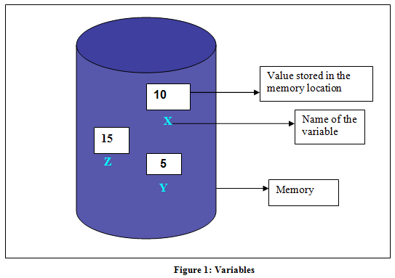
C programming language
Variables in C
Variable: placeholder helps you access data stored in memory

Slide 18
C programming language
Declaration Variables
DataType_Name Varible_Name ;
Examples :
int y;
long z ;
char letter ;
float f1;
double salary ;

Slide 19
C programming language
Rules For Declaring Variable
The name of the variable contains letters, digits, and underscores.
The name of the variable is case sensitive (ex Arr and arr both are different variables).
The name of the variable does not contain any whitespace and special characters (ex #,$,%,*, etc).
All the variable names must begin with a letter of the alphabet or an underscore(_).
We cannot used C keyword(ex float,double,class)as a variable name.

Slide 20
Declaring Variables .
#include <stdio.h>
int main() {
int 1_y;
long #z_1 ;
char letter ;
bool x_1 ;
float x#c;
double x_1_x ;
return 0;
}

Slide 21
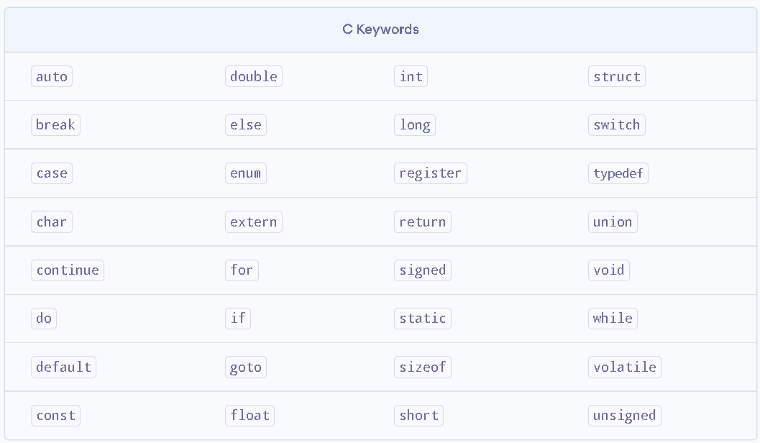
C programming language

Slide 22
#include<stdio.h>
int main()
{
int a;
float b;
long c;
double e;
char f;
printf("%a\n",a);
printf("%f\n",b);
printf("%lld\n",c);
printf(“%lf\n”\n,e);
printf(“%c\n”,f);
}

Slide 23
C programming language
Initialize Variables
DataType_Name Varible_Name = value ;
OR
DataType_Name Varible_Name ;
Varible_Name = value ;
int y = 10 ;
int y;
y = 10;
long long z = 92233720368547758 ;
char letter = ‘x’ ;

Slide 24
#include <stdio.h>
int main()
{
int x; // Declaration
int y = 5; // Declaration and Initialization
float f; // Declaration
f = 3.14; // Initialization
char c = 'h'; // Declaration and Initialization
}

Slide 25
Time to code
Write a program to declare variables :
var1, var2, var3, var4, var5
with data types : int , long long, float, double, char And, initialize these variables with these values, respectively: 5, 310000093939, 5.34, 31.000124, ’h’

Slide 26
#include <stdio.h>
int main()
{
int var1 = 5;
long var2 = 310000093939;
float var3 = 5.34;
double var4 = 31.000124;
char var5 = 'h’;
printf(“%d\n”,var1);
printf(“%lld\n”,var2);
printf(“%f\n”,var3);
printf(“lf\n”,var4);
printf(“%c\n”,var5);
}

Slide 27
C programming language
User Input
In C programming language, scanf is a function that stands for Scan Formatted String. It reads data from stdin (standard input stream i.e. usually keyboard) and then writes the result into the given arguments.
It accepts character, string, and numeric data from the user using standard input.
Scanf also uses format specifiers like printf. ( %i , %f , %c..,ect)

Slide 28

C programming language
User Input
int var; scanf(“%d”, &var);
called as address of the operator
&var is the address of var.
While scanning the input, scanf needs to store that input data somewhere.
To store this input data, scanf needs to known the memory location of a variable

Slide 29
#include <stdio.h>
int main()
{
int var1;
long var2;
float var3;
double var4;
char var5;
scanf(“%d”,&var1);
scanf(“%lld”,&var2);
scanf(“%f”,&var3);
scanf(“lf”,&var4);
scanf(“%c”,&var5);
}

Slide 30
A fresh start. A new chapter in life waiting to be written. New questions to be asked, embraced, and loved. Answers to be discovered and then lived in this transformative year of delight and self-discovery.
Sarah Ban Breathnach

